Slide 1




Decentralized Music Publishing and Discovery Platform
Available now on

Slide 2



Challenges of the Music World Today
Artists desperately need opportunities for independent music publishing
Publishing Monopoly
3 major labels (Sony, Warner Bros, Universal) own 75%+ music publishing market
Lack of Data Transparency
Due to the monopoly and the nature of Web2, music publishing data is hard to get and lacks validation
Low Income for Artists
On Spotify, artists only earn on average $400 for 1M streams.

Slide 3

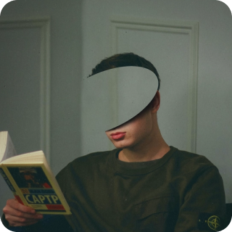



Sonorus
Permissionless Music Publishing and Monetization
With blockchain technology, Sonorus directly connects artists and their fans
Artists
Fans
Publish
Purchase
Distribute Royalty Payments
Record NFTs
Reward holders of trending music NFTs in a daily basis
Sonorus Music Heat Ranking

Slide 4

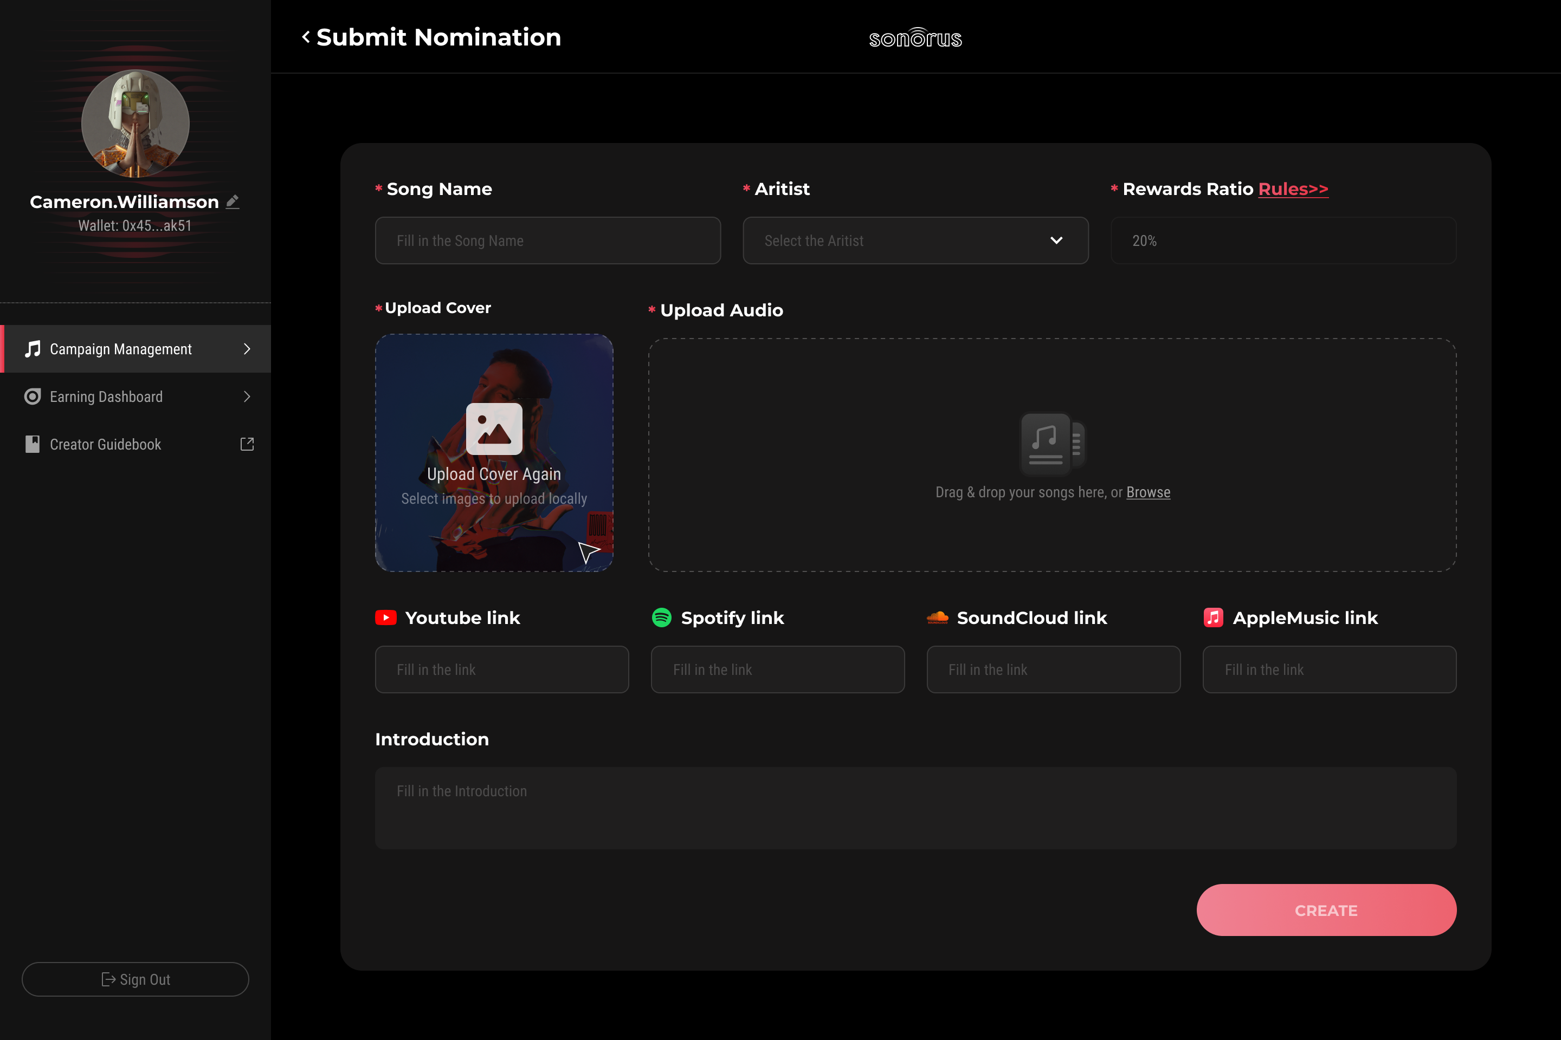



On-Chain Music NFT Publishing System
Publish your music in NFTs and access a large music collector community instantly
Upload your original music
Let other users sponsor your music with music-publishing tickets
Your music NFT is ready to sell

Slide 5

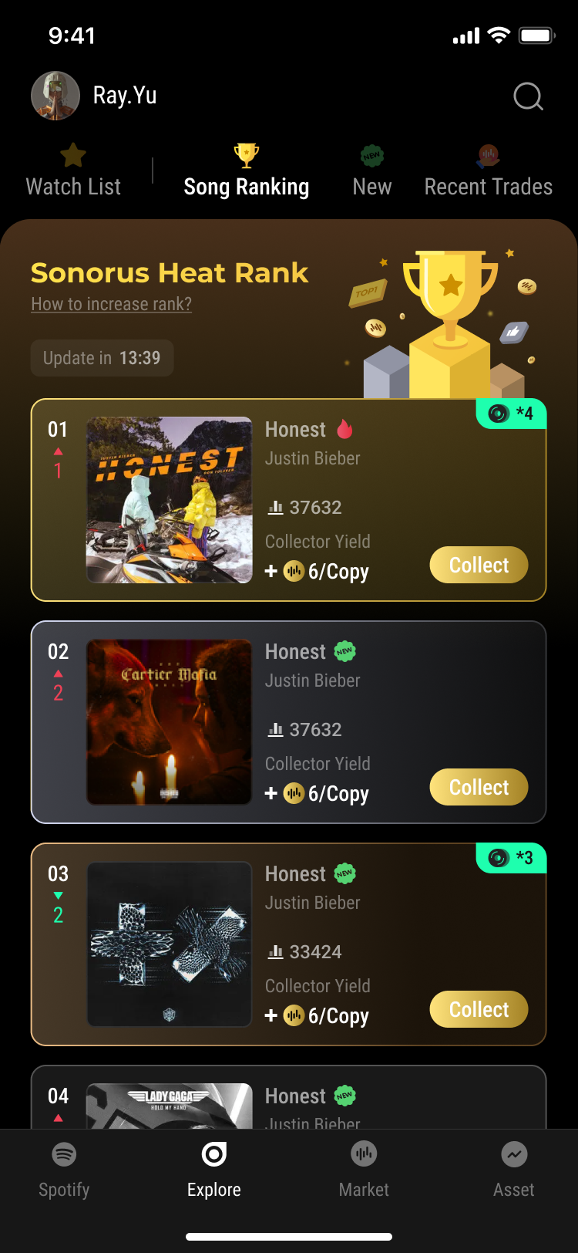

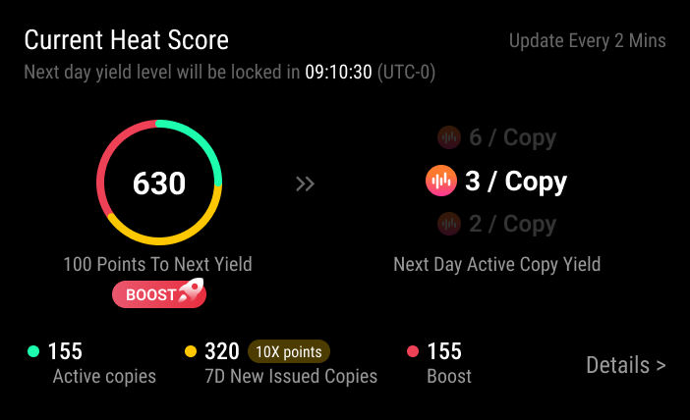


Reward Mechanism to Encourage Music Discovery by Listeners
Let the fans decide what’s trending and build music consensus
Sonorus Music Heat Rank
Sonorus automatically ranks all the music NFTs based on the number of active copies by holders and recent new mints
Daily Rewards
The higher a song ranks, the more rewards its NFT holders can collect everyday
Discover Better Music
Because of the Sonorus rewards mechanism, listeners are encouraged to find and collect better music

Slide 6
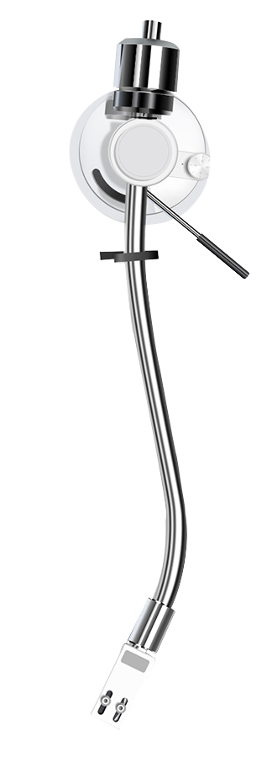





Core Advantages
over Traditional Music Publishing
More Income
Without traditional music labels as middleman in publishing, artists can earn much more from their music works
Instant Payments
Compared to the 3-6 months settlement period in the traditional way, Sonorus makes sure artists get their shares instantly
Full Transparency
Sonorus fully runs on the blockchain using smart contracts, which gives everyone full visibility to music publishing data
Better Fan Engagement
Sonorus helps mobilizes fans to support their favorite music and artists, and let both parties benefit in the process

Slide 7




Sonorus Societal Significance in Web3
Quoting Mr.Du Yu from the opening ceremony,
the Head of Wanxiang Blockchain Lab
Connection between Artists and Fans
via Blockchain
“The essence of Web3 applications lies in
Easing the entry for developers by lowering barriers.
Transparent Ranking Mechanism
Facilitating user access to the Web3 realm by minimizing hurdles."
Artists gain much more income
Trending NFT Holders earn rewards

